Slide 1
Small Enterprise Finance Agency (sefa) SMME IN ICT SUMMIT & EXPO 27 June 2024 Presented by – Don Mashele

Slide 2
DSBD PORTFOLIO
Department of Small Business Development
[DSBD]
Small Enterprise Finance Agency
[sefa]
Development Finance
Small Enterprise Development Agency
[Seda]
Business Development Support Services

Slide 3
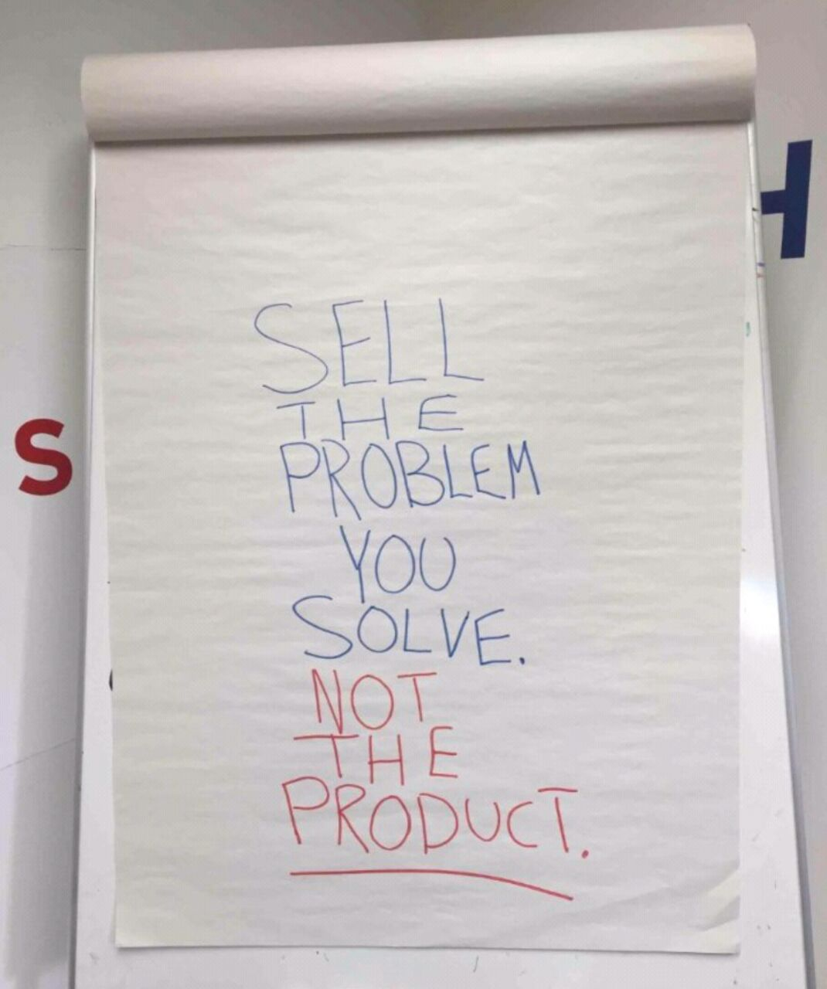

Slide 4
THE SWEET SPOT
PASSION
WHAT
YOU LOVE
JUST A DREAM
HAPPY BUT POOR
#WIN
WHAT YOU
ARE GOOD AT
RICH BUT BORED
WHAT
PAYS WELL
TALENT
BUSINESS MODEL

Slide 5
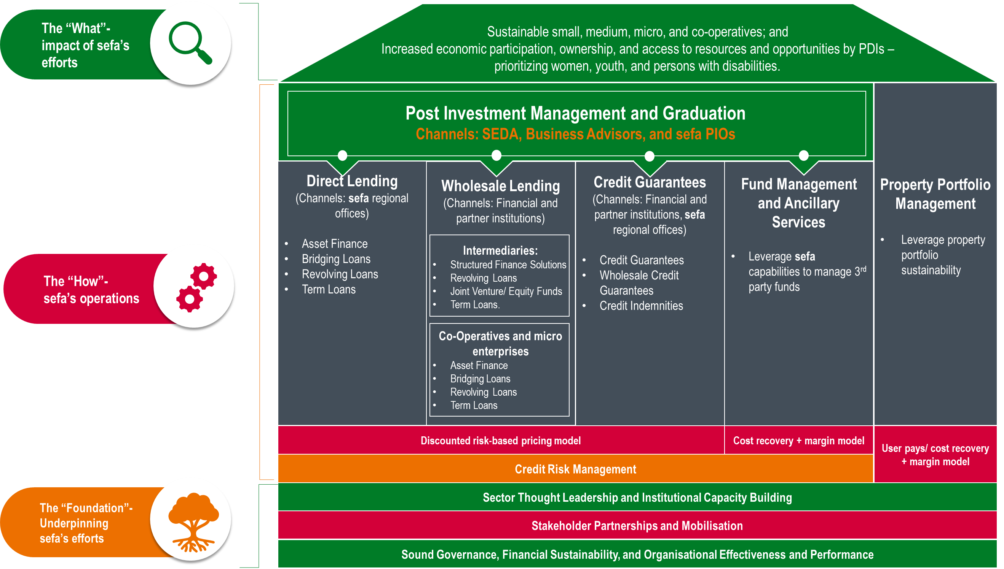
sefa’s Operating Model, Distribution Channels & Products

Slide 6
DIRECT LENDING PRODUCTS

Slide 7
Direct Lending Products
Asset Finance
Term Loans
ISAs as the name implies should be fully secured and registered in sefa’s name before the delivery of such assets to the client
Such assets should also be fully insured by the client to the full value of the asset and ceded to sefa before the client takes delivery of such assets.
For vehicles financed under ISA, the asset shall be installed with a tracking device at the expense of the client
The tracking company shall note sefa’s interest and give sefa access to such tracking device for the recovery of the vehicle in the event of a default.
The client also has an obligation to return to sefa any asset that has been financed by sefa in the event of the client having difficulty in amortising the loan.
The sale of such asset by sefa shall be used to either offset or reduce the outstanding amount.
The client is liable for the difference between the proceeds (net of selling costs) from the sale of such asset and the outstanding loan amount.
The term loan can be used for moveable assets or other working capital expenditures such as labour costs Unlike asset financing, term loans are used to acquire moveable assets that cannot be identified by means of serial numbers (e.g. office furniture, fixtures, and fittings, etc)
The purpose of the loan is to finance longer-term working capital requirements, specific capital acquisition, and/or business expansion projects
The useful life of the asset to be financed as well as the cash flow projections are used as a guideline in determining the tenure for a term loan facility

Slide 8
Direct Lending Products…cont
Bridging Loans/Contract Finance
Revolving Loans
This product is for businesses that do not have sufficient capital to fulfil their tenders or purchase orders
This is a short-term loan that is provided to an enterprise to finance working capital such as stock and/or operating overheads
Depending on the nature of the transaction, the documentation required for the assessment of such transactions may not require a business plan
The client shall obtain a cession of payment in favour of sefa where possible
However, in the absence of a cession of payment in favour of sefa. The client is expected to confirm the following undertaking:
joint bank account, where applicable
under no circumstance shall the banking details on the contract change without prior notification of the financier
that they shall supply a progress report on the completion status of the contract on a monthly basis or when requested by sefa
In the event of failing to secure the above, sefa shall use its discretion on whether to approve or decline the transaction
It is compulsory that all contracts are verified in terms of its authenticity
Telephonic verifications are not acceptable.
This product is available to sefa’s clients to facilitate short-term capital requirements
The capital repayments plus interest are structured in relation to the cash flow projections of the borrower
The loan duration of such nature shall be a maximum of 36 months and reviewed every 12 months
This is a line of credit whereby an enterprise is allowed to use the funds as and when they are needed
It is usually used for clients who have contracts with a predetermined lifespan and monetary value
Revolving credit facilities are mainly used for operating purposes and the loan amount vary from month to month depending on the client’s current cash flow needs

Slide 9
Eligibility
Eligibility Criteria
Exclusions
Natural Persons: Applicants must be South African citizens, with valid South African identity documents; Naturalised South Africans as defined in terms of BBBEE Act no 53 of 2003
Juristic Persons: legally constituted including sole traders with a fixed physical address, Partnerships, Cooperatives, Non-Profit Organisations that function as social enterprises, Close Corporations, Private Companies (PTY LTD), and Public Companies (LTD)
The financed operations must be conducted within the borders of South Africa
Controlling interest of the business enterprise must be held by a South African citizen with a valid South African identity document
The applicant shall ensure that the business maintains a staff complement consisting of at least 95% South African citizens with a valid South African identity document throughout the duration of the loan tenure
At least one member/shareholder should be operationally involved in the business
The project must demonstrate the ability to generate the level of development impact as stated in the sefa Corporate Plan such as job maintenance and or creation and economic empowerment
The business should be sustainable and commercially viable with specific reference to loan repay-ability
Risk-taking by the entrepreneur which can be reflected in their financial contribution, equity, and personal sureties
Speculative real estate - refers to the buying of property with the hopes of reselling it at a higher price in the near future
People under debt review, or unrehabilitated insolvents, as well as businesses under business rescue or liquidation
Entities/individuals whose primary business involves arms and ammunition-related transactions
Entities operating in morally reprehensive sectors as defined by the Department of Trade Industry and Competition
Entities involved in labour-broking activities
Business relationships/transactions that transgress tax, accounting, regulatory requirements, and environmental legislation
Individuals and entities listed on sefa and IDC as well as other DFI’s Delinquency registers as well as National Treasury Supplier restricted database
Acquisition of loss-making businesses without prospects of financial sustainability

Slide 10
DIRECT LENDING PROGRAMMES

Slide 11
Township and Rural Entrepreneurship Programme (TREP)
What does the scheme cover:
Financing examples:
Cost of production inputs, e.g., material, equipment, machinery, tools, etc.
Working capital including salaries, rent, etc.
Assistance with compliance and technical skills improvement, e.g., labelling, industry standards, and quality, etc
Business and financial management training, including productivity management
Facilitated market access
Example – 1: Total funding applied for R100 000 = R50k loan and R50k grant
Example – 2: Total funding applied for R150 000 = R75k loan and R75k grant
Example – 3: Total funding applied for R250 000 = R150k loan and R100k grant
Example – 4: Total funding applied for R1 000 000 = R900k loan and R100k grant
Financial Support:
Loan repayment terms:
The financial package is structured at a maximum value of R1 000 000 that consist of:
Maximum of R1 000 000 towards working capital, cost of equipment, or any other CAPEX (paid directly to the supplier where applicable)
The financial package will be offered in the form of a blended finance with 50% of the total approved amount being a Grant i.e., a maximum grant amount of R100 000.
Maximum 36 months repayment period dependent on cashflows.
Interest rate at a fixed rate of 5%.
3 months moratorium (on capital and interest)

Slide 12
Township and Rural Entrepreneurship Programme - continued
Types of Businesses
Eligibility Criteria
The Scheme supports all small enterprises operating in townships and rural areas that meet the qualifying criteria including but not limited to the following sectors:
Clothing & Textile
Bakeries & Confectionaries
Tshisanyama and Cooked Food
Retail (including restaurants, car washes, general dealers etc.
Automotive
Personal Care
Artisans
An entity registered with CIPC including cooperatives;
The business must be 100% owned by South African nationals;
Employees must be 70% South Africans, and in the case of non-South African employees – they must hold valid work permits;
The enterprise must be operating in a township or rural area;
The enterprise or its owner must possess or willing apply for a business license after the funding has been provided, with the local municipality;
The enterprise must be registered or must apply for registration with SARS and UIF;
The enterprise must have a valid business bank account or willing to open and operate a business account

Slide 13
Amavulandlela Funding Scheme
Financial Support
Additional Customised Benefits
The scheme offers entrepreneurs with disabilities credit facilities ranging from R50 000 up to R15 million
Preferential variable interest rate – Prime less 5% per annum
Repayment terms for facilities will be up to 60 months. The actual loan duration will be subject to the projected cash flows of the business
Normal sefa loan administration fees will apply
The scheme offers the following non-financial support:
Pre-Approval Assistance (only if required)
Will be for up to 5% of the total intended investment but not exceeding R75 000
Will be targeted assistance to bring the application to a bankable stage, including mentoring, technical assistance, sourcing, and negotiating with suitable suppliers
Repayable grant and shall have a moratorium of 3 months after disbursement (if the loan application has been approved)
Post-Approval Assistance (for a maximum amount of up to R350 000)
This will be used for in-depth mentoring and coaching as well as any other business support required up to 2 years

Slide 14
SMALL ENTERPRISE MANUFACTURING SUPPORT PROGRAMME (SEMSP)

Slide 15
Small Enterprise Manufacturing Support Programme
Financial support
Eligibility criteria
Funding to purchase machinery and equipment for the various manufacturing sub-sectors that will be supported
Working capital for the various manufacturing sub-sectors that will be supported
Funding for product accreditation, certification, and testing
The applicant must:
Be a registered legal entity in South Africa in terms of the Companies Act, 1973 (as amended); Close Corporations Act, 1984 (as amended); and the Cooperatives Act, 2005 (as amended).
Be a 100% owned by South African citizens.
Have been in operation for at least two years prior.
Be predominantly black-owned (51%).
Have a predominantly black management team (51%).
Be registered and compliant with the South African Revenue Service (where applicable).
Funding terms
Funding of up to a maximum of R15 million per small enterprise
The term of the funding will be determined by the business cash flows up to a maximum of 84 months per small enterprise with a maximum moratorium of 3 months
Blended finance instrument will be utilised where up to 20% of the funding required could be a grant and the balance could be a loan
The loan will be repayable at a prime lending rate

Slide 16
Youth Challenge Fund

Slide 17
Youth Challenge Fund…cont
Financial Support
Eligibility Criteria
Both channels will receive a START-UP maximum of R2 million
Both channels will receive GROWTH maximum of R15 million
Within the red channel 40% will be allocated as a grant and 60% loan
Within the blue channel 30% will be allocated as a grant and 70% loan
Growth blended finance is 20% grant and 80% loan in both red and blue channels
In line with National Youth Policy, the YCF will be providing support to youth start-up businesses/enterprises that meet the following criteria:
Are between the age of 18 to 35 years.
Registered with CIPC, and willing to register with SARS & UIF (if not registered)
100% South African-owned enterprises
Are adequately involved in the day-to-day operation and management of the business with at least one or more of the member/shareholders being a full-time employee of the business, especially the main applicant.
Prepared to participate in BDS and mentorship (pre and post)
Commercially viable, sustainable, and feasible business idea.
 | Red Channel | Blue Channel
Focus of Channel | Technology & Innovation | Other Sectors
Start-up Maximum per Enterprise | R2mil | R2mil
Start-up Blended Finance | 40% grant / 60% loan | 30% grant / 70% loan
Growth Maximum per Enterprise | R15mil | R15mil
Growth Blended Finance | 20% grant / 80% loan | 20% grant / 80% loan

Slide 18
Application Checklist
Affordability testing
Cash flow projections
Loan Breakdown
Supporting quotations (with contact person and banking details of supplier)
Personal Income and Expenditure Schedule and Assets & Liability Statement
Proof of own contribution and source (if applicable)
If a judgment, notice, default is issued against the applicant, a letter or document to prove that arrangements are made to settle the
account or proof that the account is settled must be provided
Historic Financial statements (not less than 3 years – if applicable)
Up to date Management Accounts (if applicable)
Debtors Age Analysis (if applicable)
Creditors Age Analysis (if applicable)
Six months latest bank statement (personal and business)
Lease agreement (if applicable)
Franchise Agreement (if applicable
Project plan and projections (contract financing)
Copy of Contract or Order
Know your client (FICA)
Certified copy of ID and that of Spouse (if married In Community of Property [ICOP])
Marriage certificate (where applicable)
Proof of residence – utility bill / sworn affidavit (not older than 3 months)
Capacity to deliver
Short CV of the members/directors/ shareholders/ trustees, etc.
Completion certificate for previous work done (for construction projects only)
Funding template or Company Profile (TREP)
Commitment
Surety Form (where applicable) – we don’t require tangible security as we are a cashflow lender (risk capital)
Compliance
Valid Tax Clearance Certificate
Company Registration Documents e.g. CK2, Company Profile
Proof of CIPC/CIPRO annual fees
Member’s resolution to apply (if applicable)

Slide 19
Funding Template
https://www.sefa.org.za/uploads/files/files/Common-Funding-Template.pdf
1. Company Information
2. Shareholder(s) Information
3. Company Structure
4. Business Operations
5. Products and Services
6. Market (Industry) Analysis
7. Target Market
8. Marketing Strategy
9. Sales Strategy
10. Competitive Environment
11. Location
12. External Environment (Political; Economic; Social; Technology; Environmental; Legal)
13. Funding Requirements
14. Financial Model
15. Banking Information
16.Supplier Information
17. Staffing
18. Compliance Environment
19. SWOT Analysis

Slide 20
DIFFERENT TYPES OF FUNDING
There are not monthly repayments
You are giving up a portion of our business to the funder
You retain full ownership of your business
There are monthly repayments (interest and capital)
sefa is a debt lender – not an equity investor

Slide 21
sefa’s CONTACTS
CONTACT US
Website | www.sefa.org.za – online application portal
Switchboard | 27 12 748 9600
Central Email | helpline@sefa.org.za / complaints@sefa.org.za
 | @TheRealSEFA
Facebook | SmallEnterpriseFinanceAgency
Linkedin | the-small-enterprise-finance-agency

Slide 22
22

